Slide 1
Theory of Computation
Dr. Sujit Kumar Das

Slide 2
NFA to DFA
In Non-Deterministic Finite Automata,
For some current state and input symbol, there exists more than one next output states.
A string is accepted only if there exists at least one transition path starting at initial state and ending at final state.
The following steps are followed to convert a given NFA to a DFA-
Step-01:
Let Q’ be a new set of states of the DFA. Q’ is null in the starting.
Let T’ be a new transition table of the DFA.

Slide 3
Step-02:
Add start state of the NFA to Q’.
Add transitions of the start state to the transition table T’.
If start state makes transition to multiple states for some input alphabet, then treat those multiple states as a single state in the DFA.
In NFA, if the transition of start state over some input alphabet is null, then perform the transition of start state over that input alphabet to a dead state in the DFA.

Slide 4
Step-03:
If any new state is present in the transition table T’,
Add the new state in Q’.
Add transitions of that state in the transition table T’.
Step-04:
Keep repeating Step-03 until no new state is present in the transition table T’.
Finally, the transition table T’ so obtained is the complete transition table of the required DFA.

Slide 5
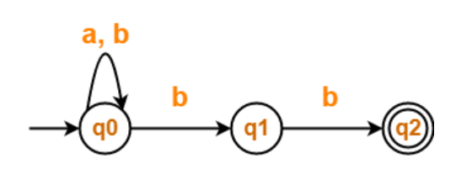
State / Alphabet | a | b
→q0 | q0 | q0, q1
q1 | – | *q2
*q2 | – | –

Slide 6
Step-01:
Let Q’ be a new set of states of the Deterministic Finite Automata (DFA).
Let T’ be a new transition table of the DFA.
Step-02:
Add transitions of start state q0 to the transition table T’.
State / Alphabet | a | b
→q0 | q0 | {q0, q1}

Slide 7
Step-03:
New state present in state Q’ is {q0, q1}.
Add transitions for set of states {q0, q1} to the transition table T’.
State / Alphabet | a | b
→q0 | q0 | {q0, q1}
{q0, q1} | q0 | {q0, q1, q2}

Slide 8
Step-04:
New state present in state Q’ is {q0, q1, q2}.
Add transitions for set of states {q0, q1, q2} to the transition table T’.
State / Alphabet | a | b
→q0 | q0 | {q0, q1}
{q0, q1} | q0 | {q0, q1, q2}
{q0, q1, q2} | q0 | {q0, q1, q2}

Slide 9
Step-05:
Since no new states are left to be added in the transition table T’, so we stop.
States containing q2 as its component are treated as final states of the DFA.
Finally, Transition table for Deterministic Finite Automata (DFA) is-
State / Alphabet | a | b
→q0 | q0 | {q0, q1}
{q0, q1} | q0 | *{q0, q1, q2}
*{q0, q1, q2} | q0 | *{q0, q1, q2}

Slide 10
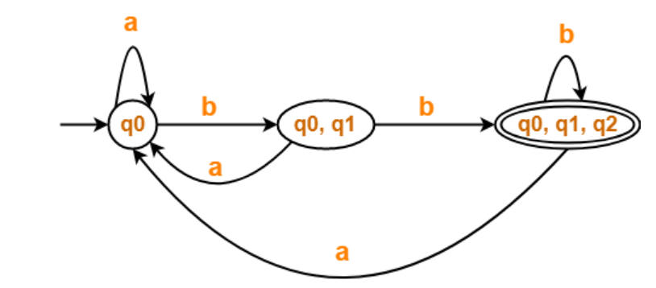
Final DFA

Slide 11
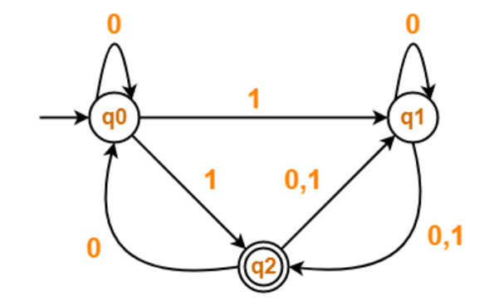
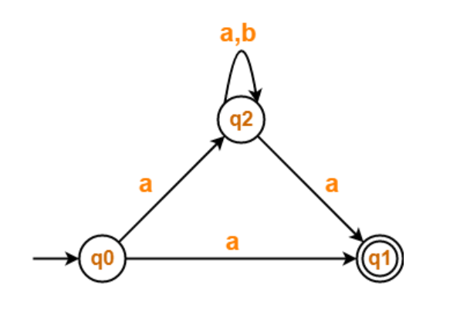
Exercise
1.
2.

